Slide 1
Suicide Analysis(1985 to 2016)
PREVENT SUICIDE: TEND THE HAND AND SAVE LIVES
Jinal Butani

Slide 2
Problem
More than 800,000 people around the world die from suicide every year.
For each suicide, there is the probability of having committed more than 20 attempts.
75% of suicides occur in low-income and medium countries.
United Nations Development program one held the research about suicides over worldwide.
The Dataset includes country,year,sex,age,suicides_no,population,suicides/100k pop,country-year,HDI for year,gdp_for_year ($),gdp_per_capita ($),generation
World health organization is also concern about this .

Slide 3
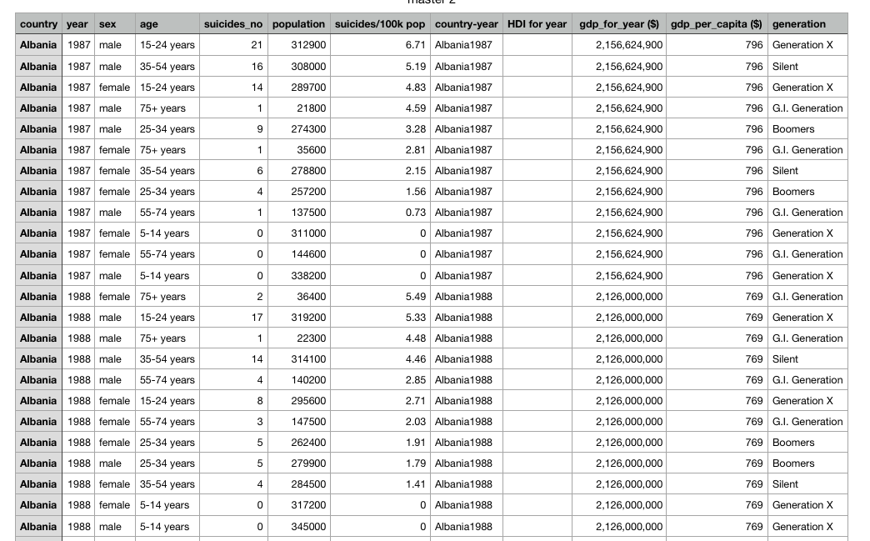

Slide 4
Goal
To prevent suicide

Slide 5
Solution
Suicides are preventable. For national responses to be effective, a comprehensive multi sectoral suicide prevention strategy is needed.
Training programs for non-specialized health workers in the assessment and management of suicidal behaviors is a key way forward in suicide prevention
Systematic follow-ups and effective community support are recommended to reduce suicide deaths and attempts

Slide 6
Solution
Tableau is very powerful software for making visuals.
This visuals will give very surprising details about what is going in the world.
So for preventing the problem all the health related organizations can have exact idea aout what they can do.

Slide 7
Thank you

